Slide 1
Natural Language Processing
Unit 13 Topic Modeling
Faizan Javed
DataScience @ SMU

Slide 2
Admin notes
HW7 due today
HW8 due 1 hr before live session 15

Slide 3
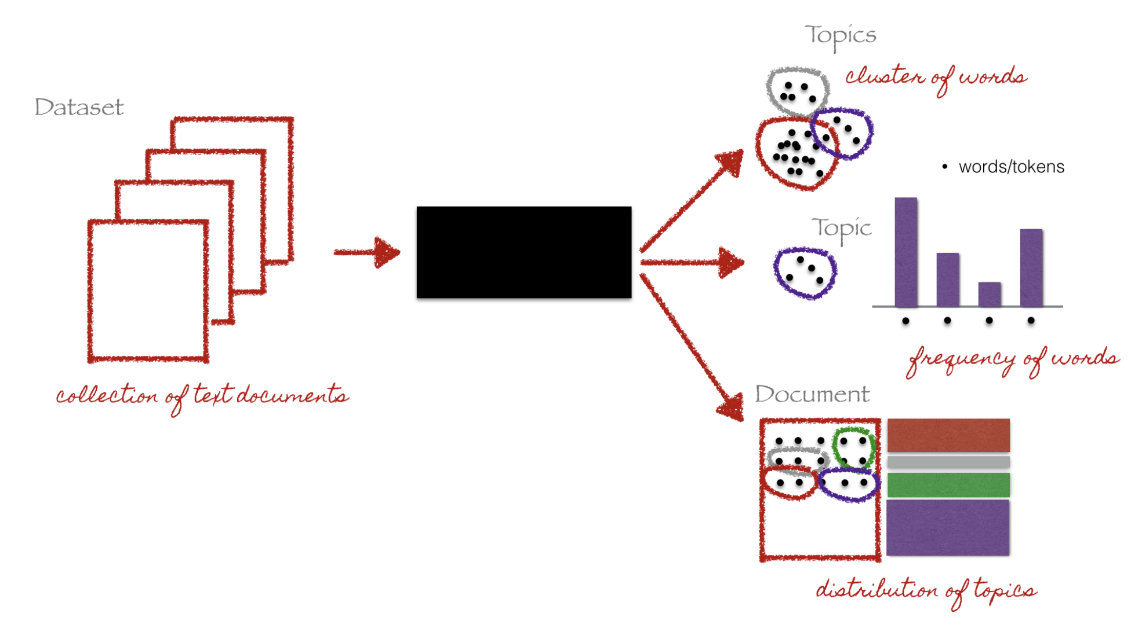
Topic Modeling
Topic: cluster of words that occur together and define a theme.
Statistical language models for discovering hidden structure in a collection of documents.
Algorithms that discover thematic structure in documents.
A way to analyze large volumes of unlabeled text.

Slide 4
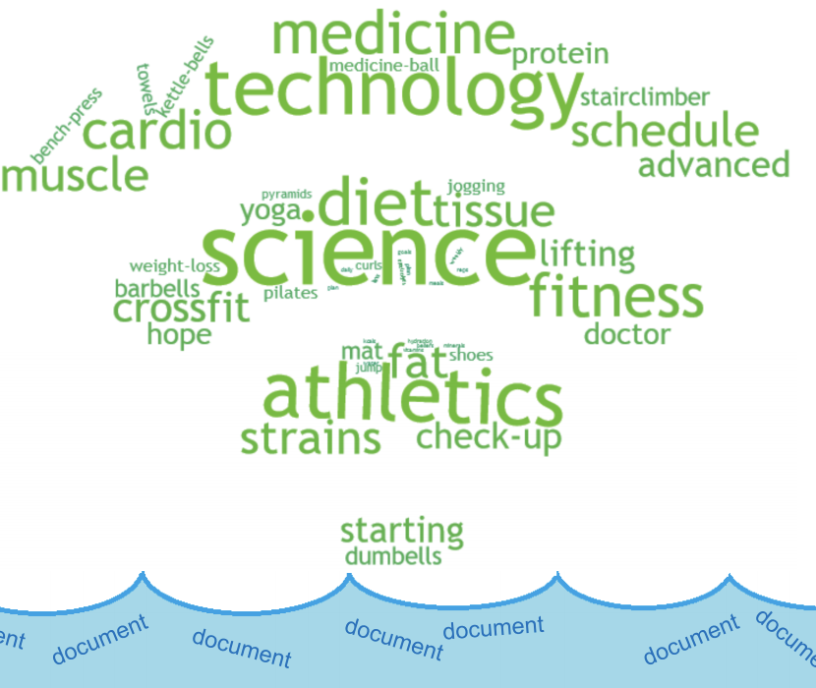
Types of Topic Modeling
Canonical : match a preestablished list of domain-specific topics. E.g., Digital Music, Electronics, Home & Kitchen, Automotive, et al
Organic : discover clusters from documents without
establishing a list of topics beforehand
Entity-centric :
topics are related to a set of named entities in a domain
E.g., entities for a streaming movie service: actors, directors, producers, genre, et al

Slide 5
Applications
Dimensionality reduction: representing text in topic space vs feature space. Topics can be used to improve classification (use topics as features)
Search and recommender systems: search results clustering/grouping search facets, recommending similar items
Uncovering themes in texts: extracting themes and topics from product reviews, comments, news articles, etc

Slide 6
Latent Semantic Analysis (LSA)
Uncovers latent hidden terms which correlate semantically to form topics.
Words that are close in meaning will occur in similar pieces of text (hence topics are unlikely to share words)
Step 1: Create a term-document matrix (using term count or TF-IDF): rows are unique words, columns represent documents
Step 2: Use Singular Value Decomposition (SVD) to reduce number of rows but preserve column similarity) – because the matrix can be very sparse and noisy
Step 3: Compare documents by cosine similarity between two vectors formed by two columns

Slide 7
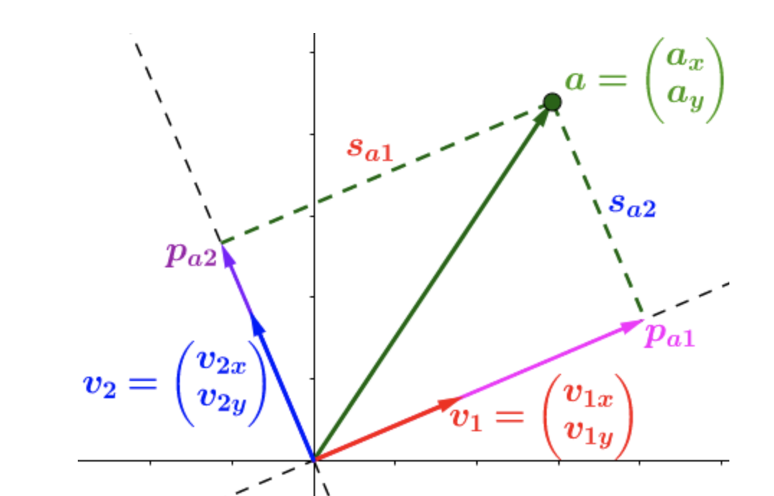
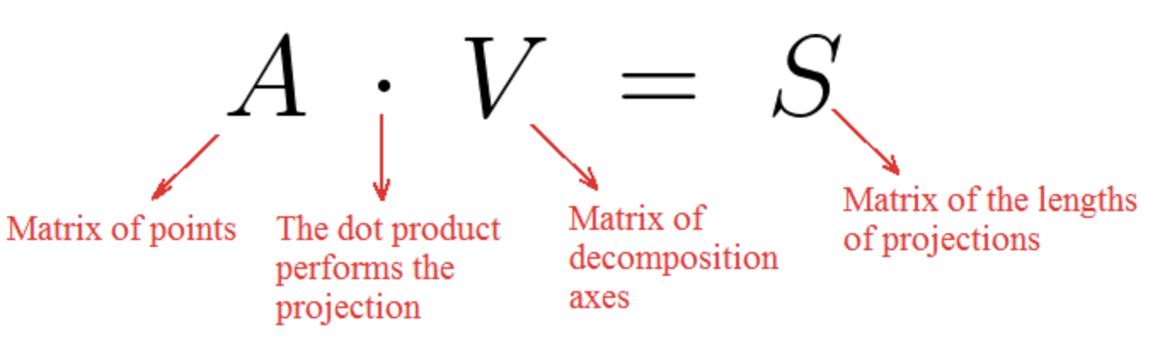
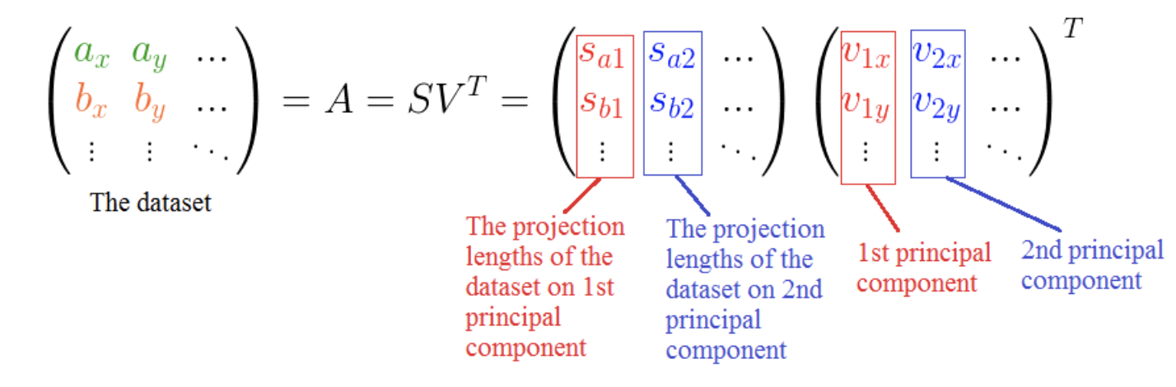
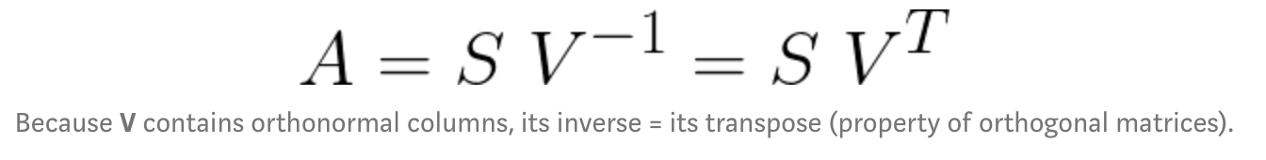
Singular Value Decomposition (SVD)
Any set of vectors (A) can be expressed in terms of their lengths of projections (S) on some set of orthogonal axes (V).
Direction of unit vectors v1, v2
Length of projections Sa1, Sa2
Vectors of projection Pa2, Pa2

Slide 8
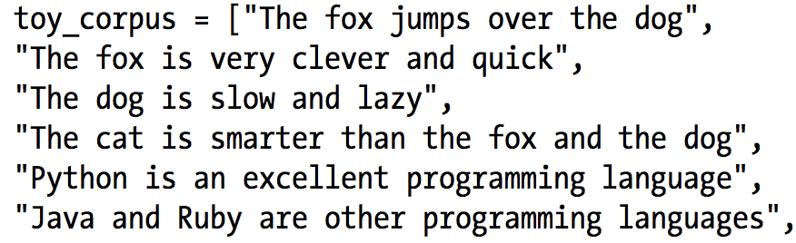
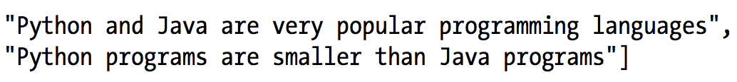
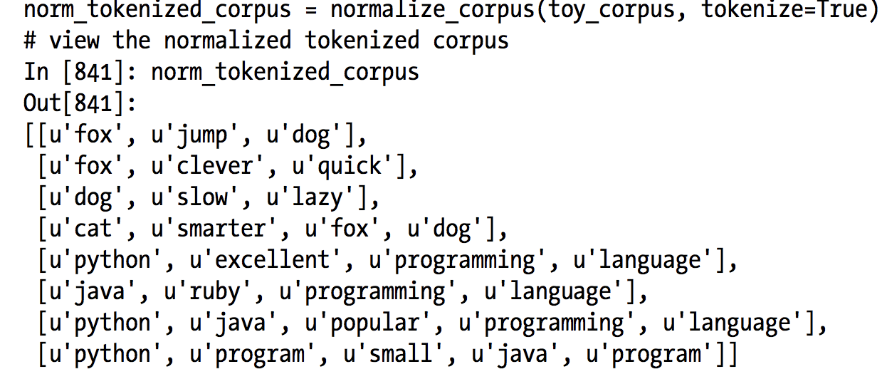
LSA example
Toy corpus:
Pre-processing: stop word removal, stemming, etc

Slide 9
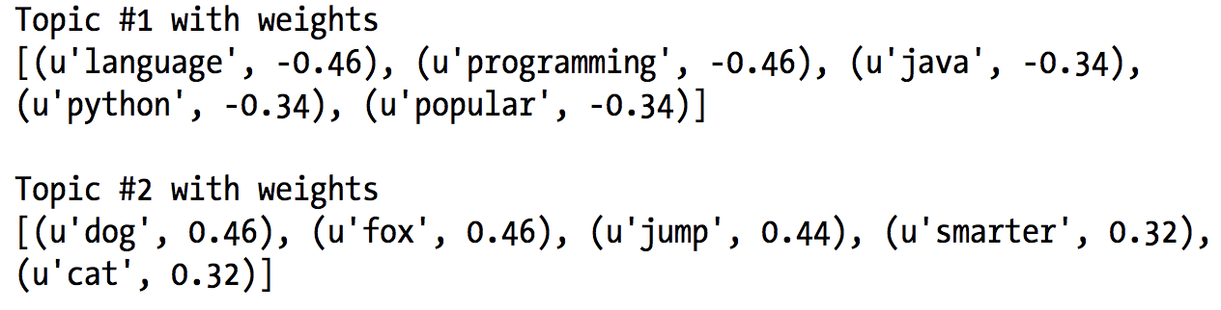
TF-IDF weighted model + # of topics = 2
The sign of the weights indicates the direction of the topic, i.e.,, similar correlated terms in the topics will have the same sign or direction.

Slide 10
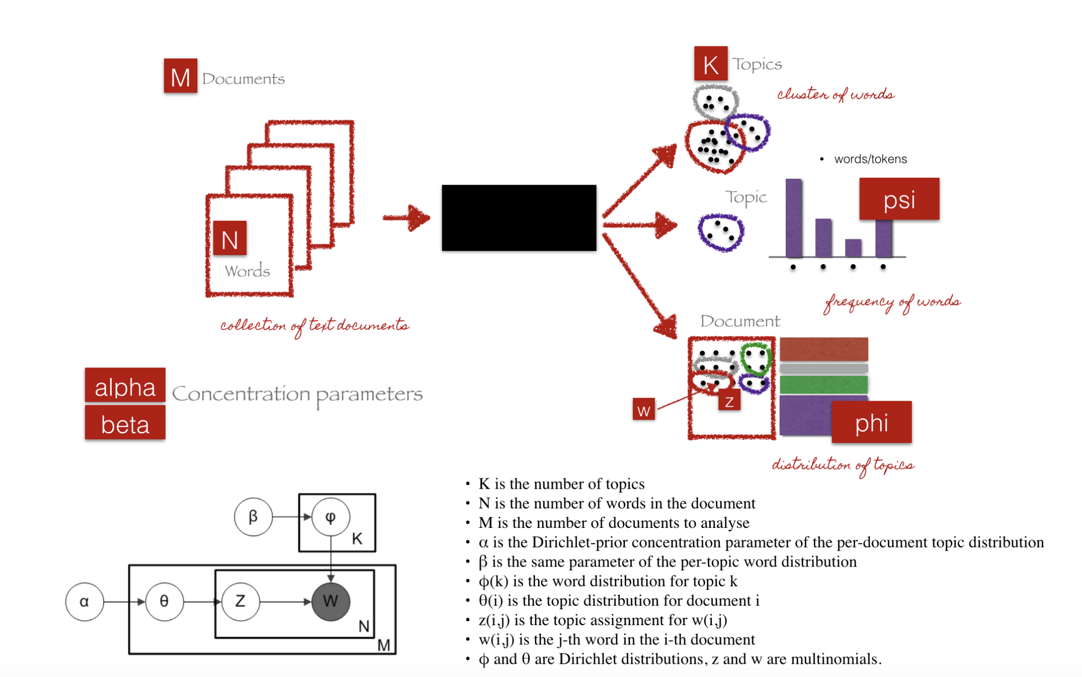
Latent Dirichlet (LDA)
Generative probabilistic model – each item of a collection (document) is modelled as a finite mixture over an underlying set of topic probabilities; each topic is modelled as an infinite mixture over an underlying set of word probabilities.
Probability distributions over words vs topic-topic matrix (LSA) – different topics can share keywords

Slide 11
Concentration parameters:
Alpha: is a Dirichlet prior concentration parameter that represents document-topic density — with high alpha, documents are assumed to be made up of many topics (documents contain similar topic content)
Beta: represents topic-word density — with high beta, topics are assumed to contain a mixture of many words (topics contain similar word content)

Slide 12
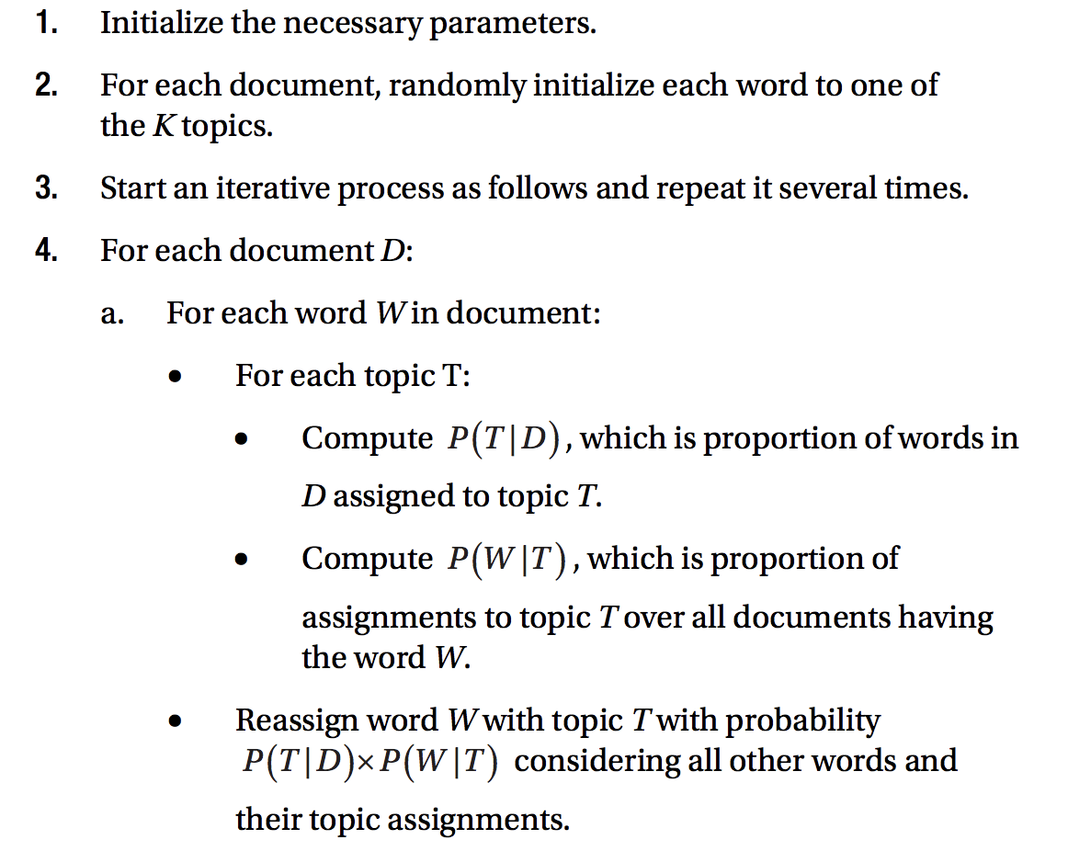
LDA Algorithm

Slide 13
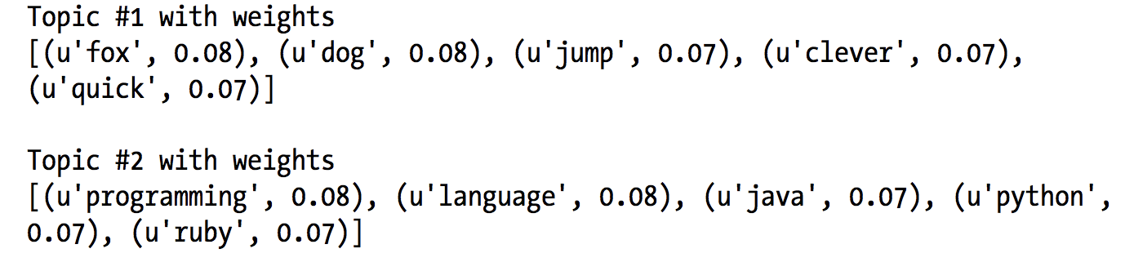
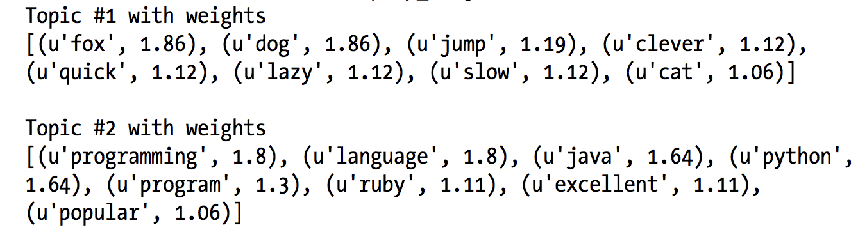
LDA example
Gensim:
SKLearn:

Slide 14
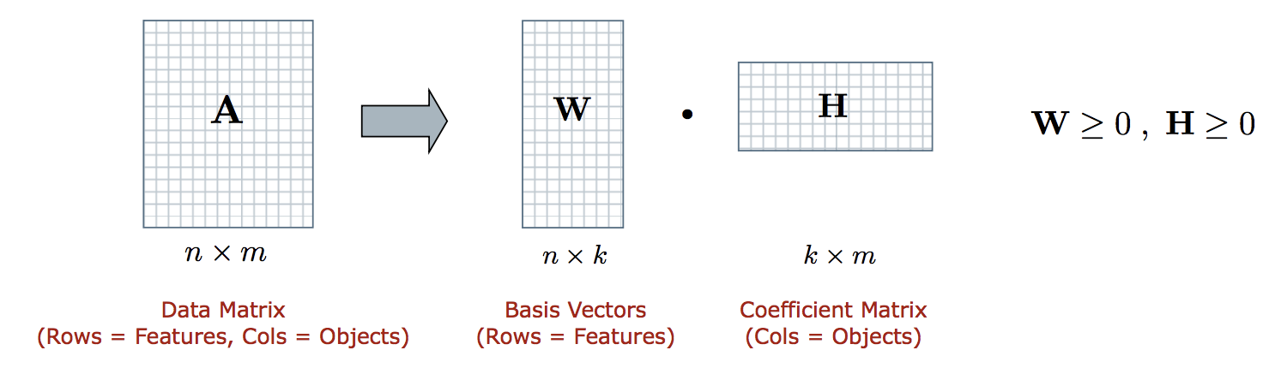
Non-negative Matrix Factorization (NMF)
Decomposes latent relationships in a data matrix
Approximates each object (i.e. column of A) by a linear combination of k reduced dimensions or “basis vectors” in W. (each basis vector is a cluster)
Expectation-Maximization (EM) style optimization for W and H
Works well for small number of documents

Slide 15
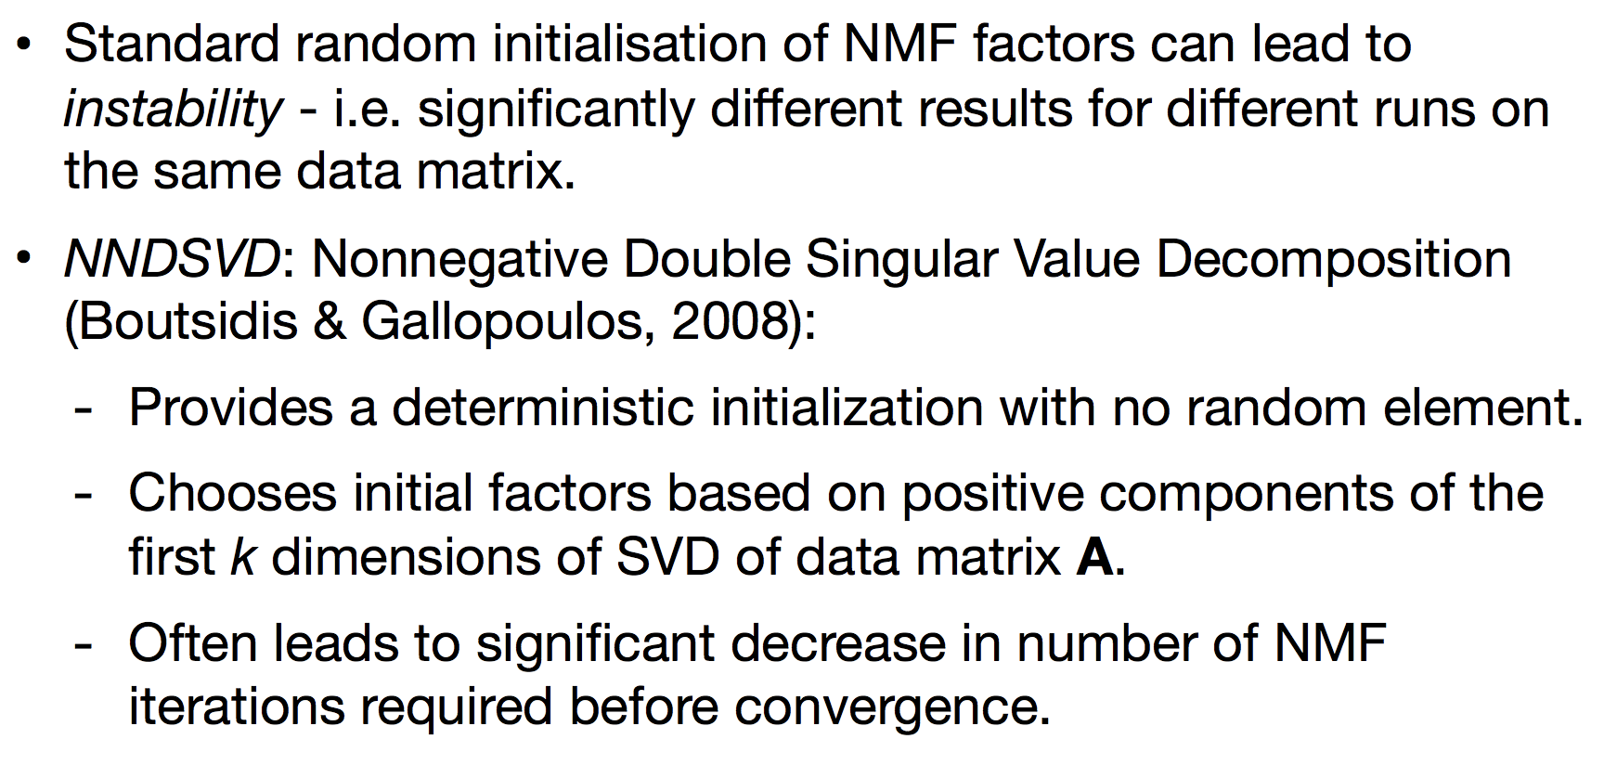
Algorithm initialization

Slide 16
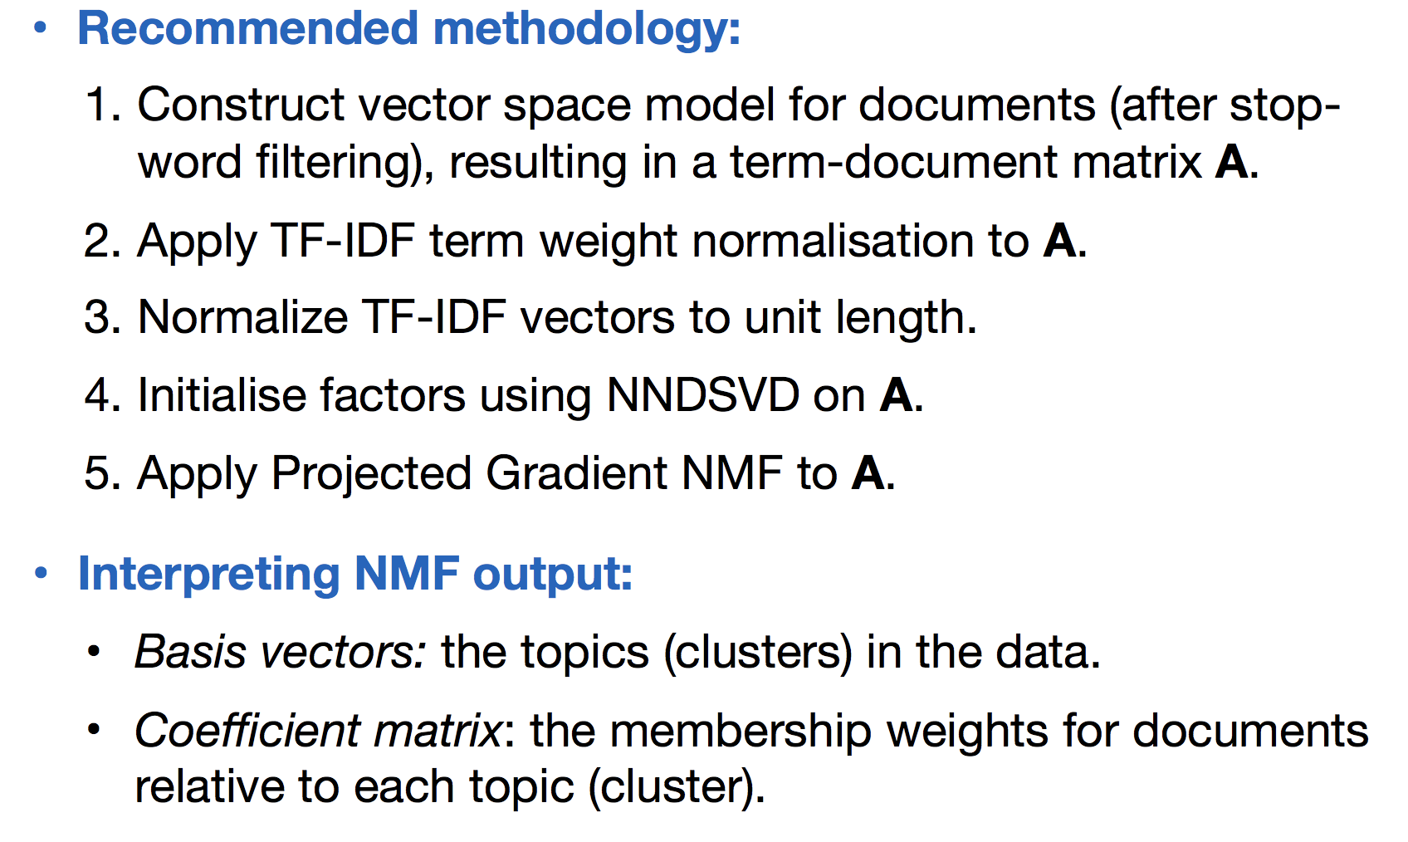

Slide 17
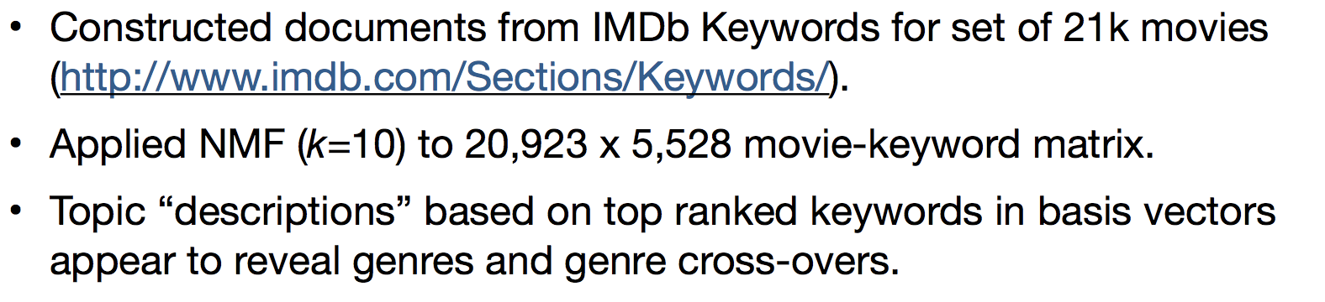
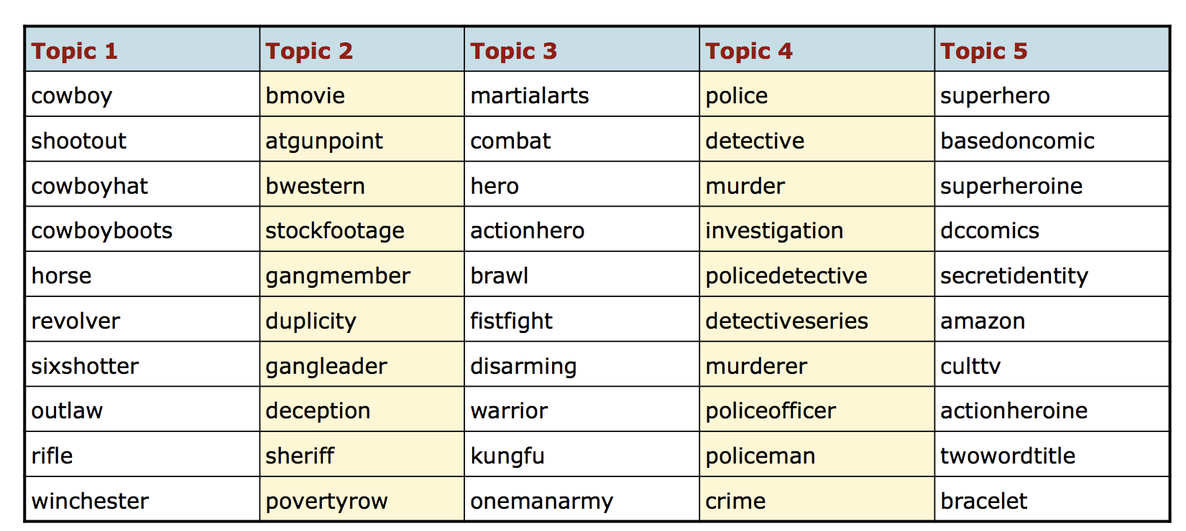
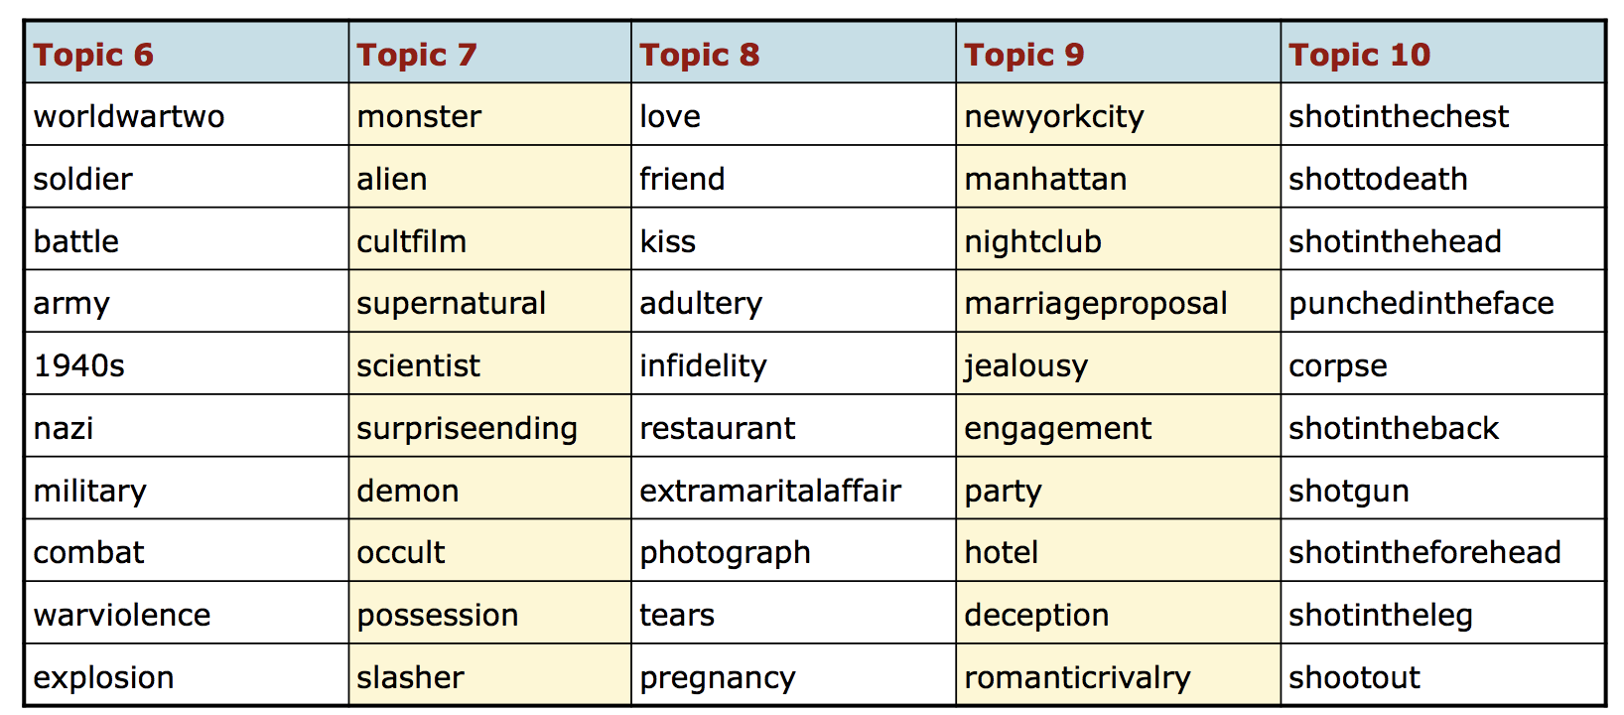

Slide 19
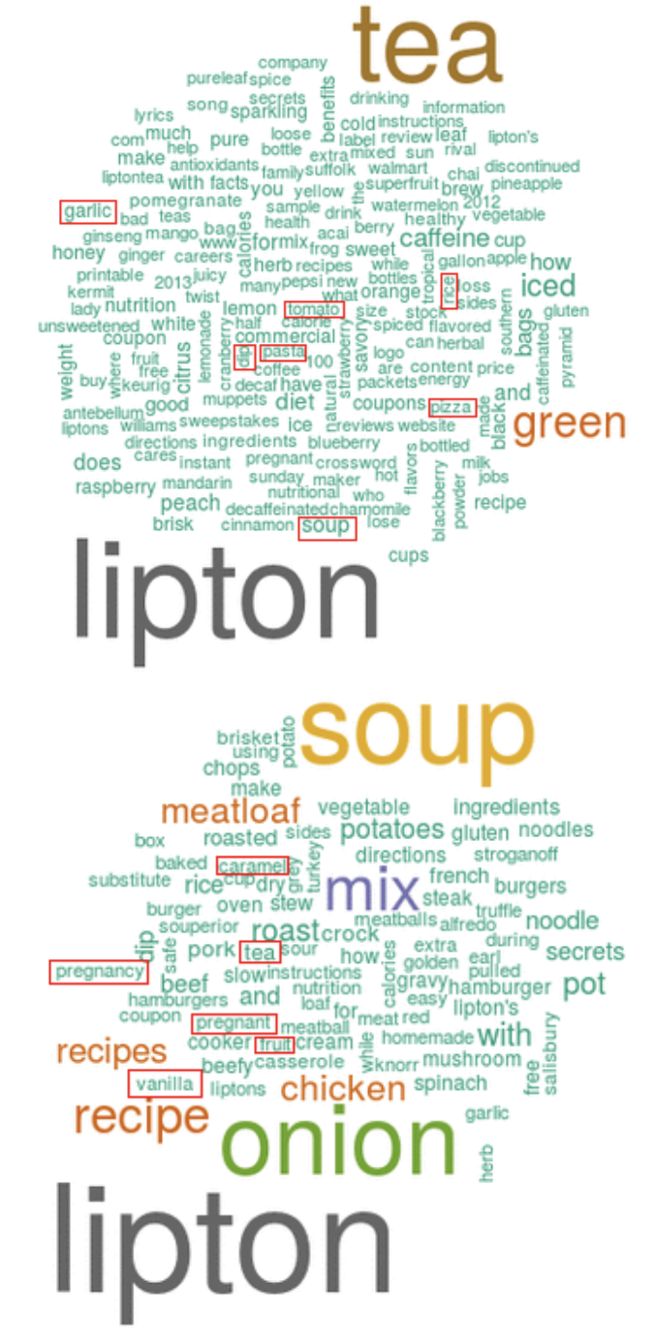
Semantic Topic Modeling Improving semantic topic clustering for search queries with word co-occurrence and bigraph co-clustering, Google 2016 https://static.googleusercontent.com/media/research.google.com/en//pubs/archive/45569.pdf
Find common topics in queries to get deeper insights
E.g., grouping queries for the “Electronics” category can find new and trending topics
Queries are short-text, sparse, and don’t provide enough word counts for models to learn how words are related and to disambiguate multiple meanings of a single word. (e.g., see LDA output with words in incorrect categories)

Slide 20
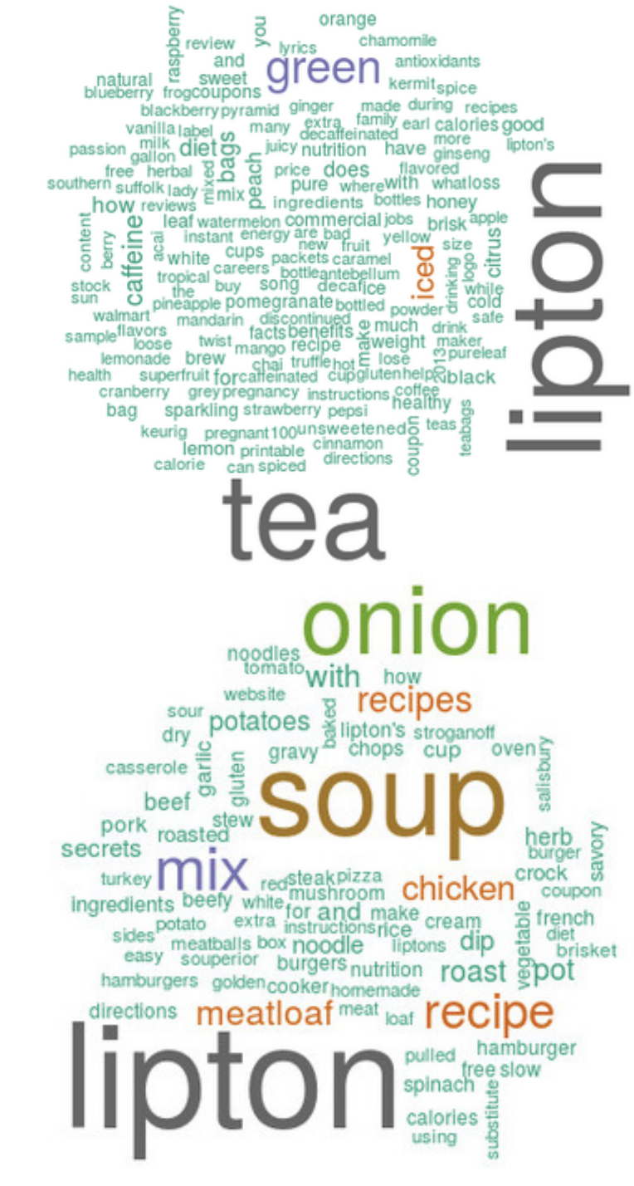
Word co-occurrence clustering: forms topic-anchors, which are words most likely to searched for in the context of queries (these are interesting words in a query). Then finds words that co-occurs with these topic anchors.
E.g., see Word co-occurence cluster for Lipton
Weighted-bigraph co-clustering: documents and words are nodes, term frequencies are edges.
View clickthrough data from search queries to URL as a bipartite graph.
URLs can identify queries of similar meaning.
URLs that are shown as top search results for a single query are somewhat similar. Hence, queries naturally group similar URLs to together.

Slide 21
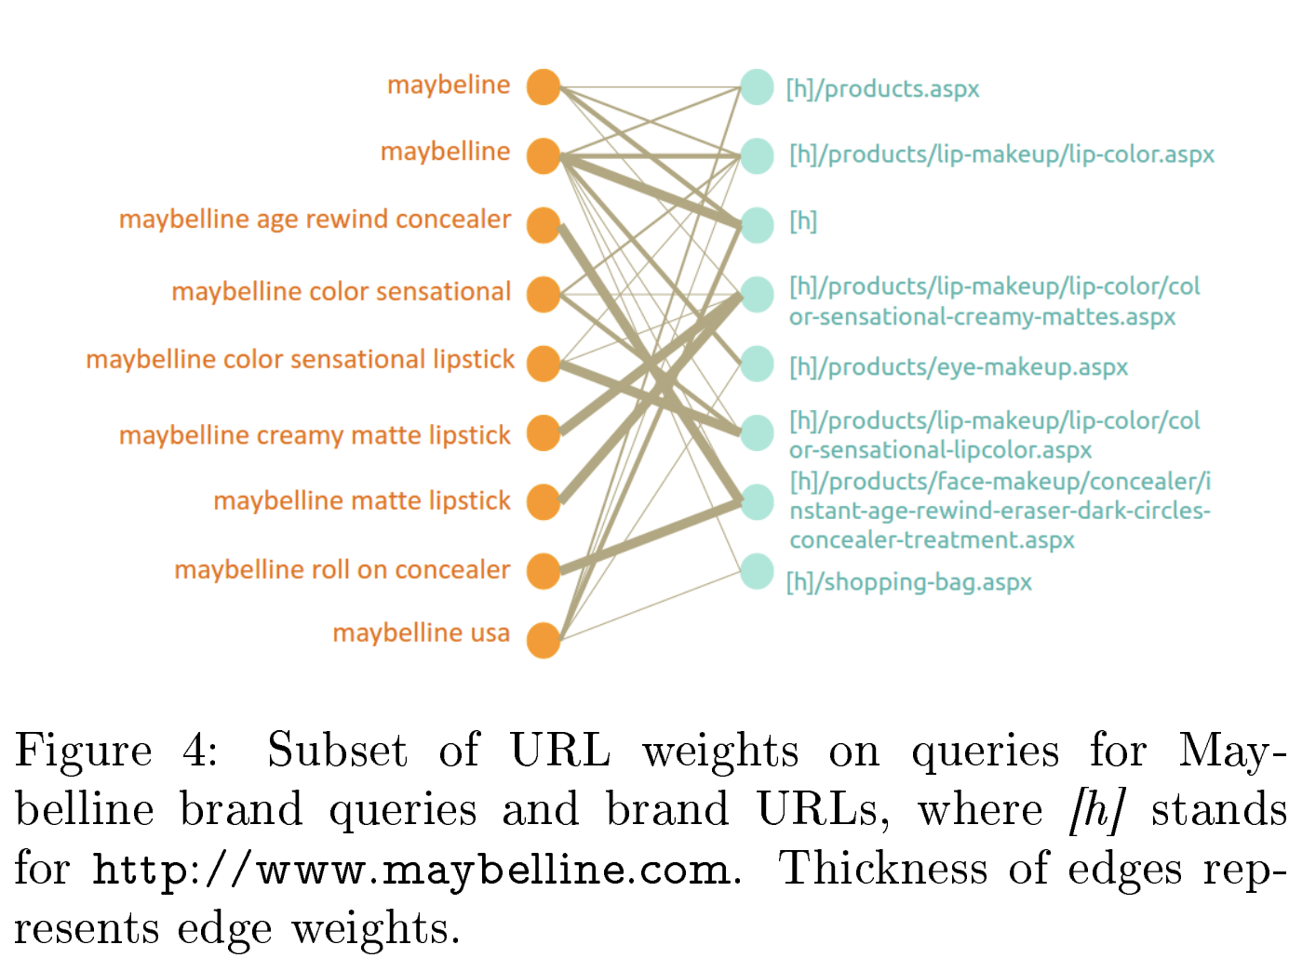

Slide 22
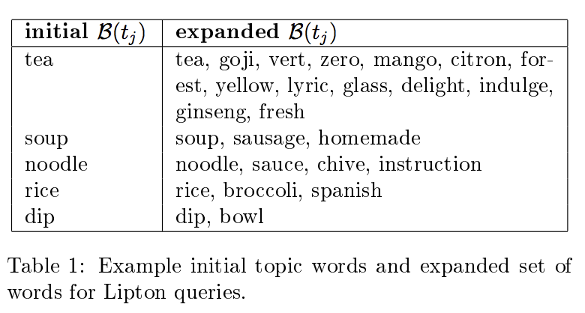
Algorithm for word co-occurrence clustering:
Step 1: Create hashmap of words and queries that contain those words:
e.g., key: “lipton”, values: “lipton chicken soup” and “lipton green tea”
Step 2: Initialize topics: Topics are initialized with a sub-selection of keys of the hashmap.
E.g., for “best maybelline mascara” the word `best' is not as interesting as `mascara' in the context of the Maybelline brand.
Use lift score to rank the words by importance and then threshold it to obtain a set of words highly associated with the context.
Step 3: Expand topics based on word co-occurrence:
for beauty products, “shape eyebrow” is a
valid combination, but “shape lips”

Slide 23
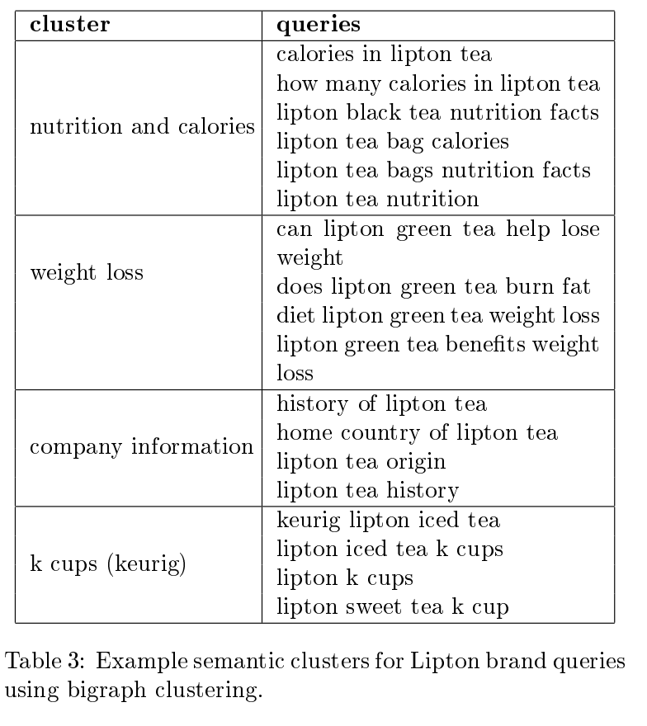
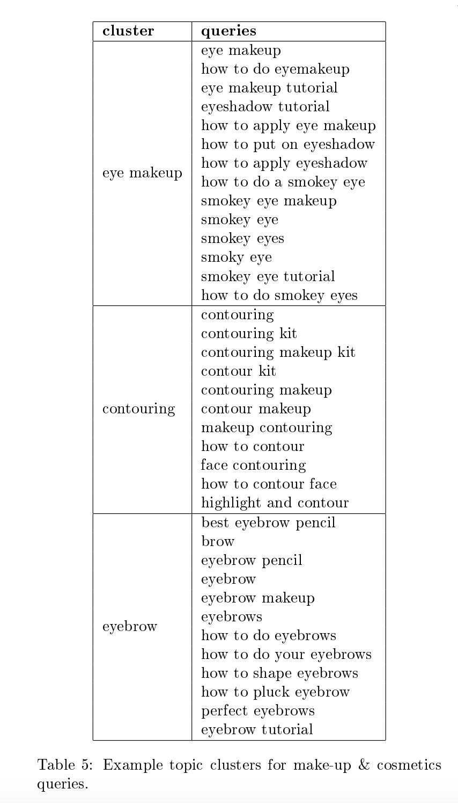

Slide 24
What did you learn today?
Questions?

